Slide 1

Advanced x86: BIOS and System Management Mode Internals PCI {Option/Expansion} ROMs
Xeno Kovah && Corey Kallenberg
LegbaCore, LLC

Slide 2
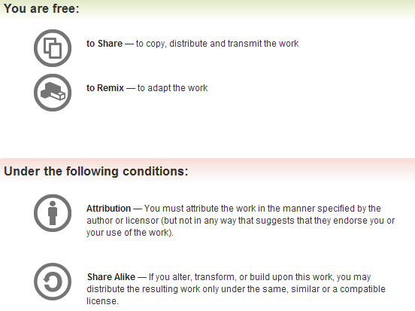
All materials are licensed under a Creative Commons “Share Alike” license.
http://creativecommons.org/licenses/by-sa/3.0/
Attribution condition: You must indicate that derivative work
"Is derived from John Butterworth & Xeno Kovah’s ’Advanced Intel x86: BIOS and SMM’ class posted at http://opensecuritytraining.info/IntroBIOS.html”
Notes:
Attribution condition: You must indicate that derivative work
"Is derived from John Butterworth & Xeno Kovah’s ’Advanced Intel x86: BIOS and SMM’ class posted at http://opensecuritytraining.info/IntroBIOS.html”

Slide 3
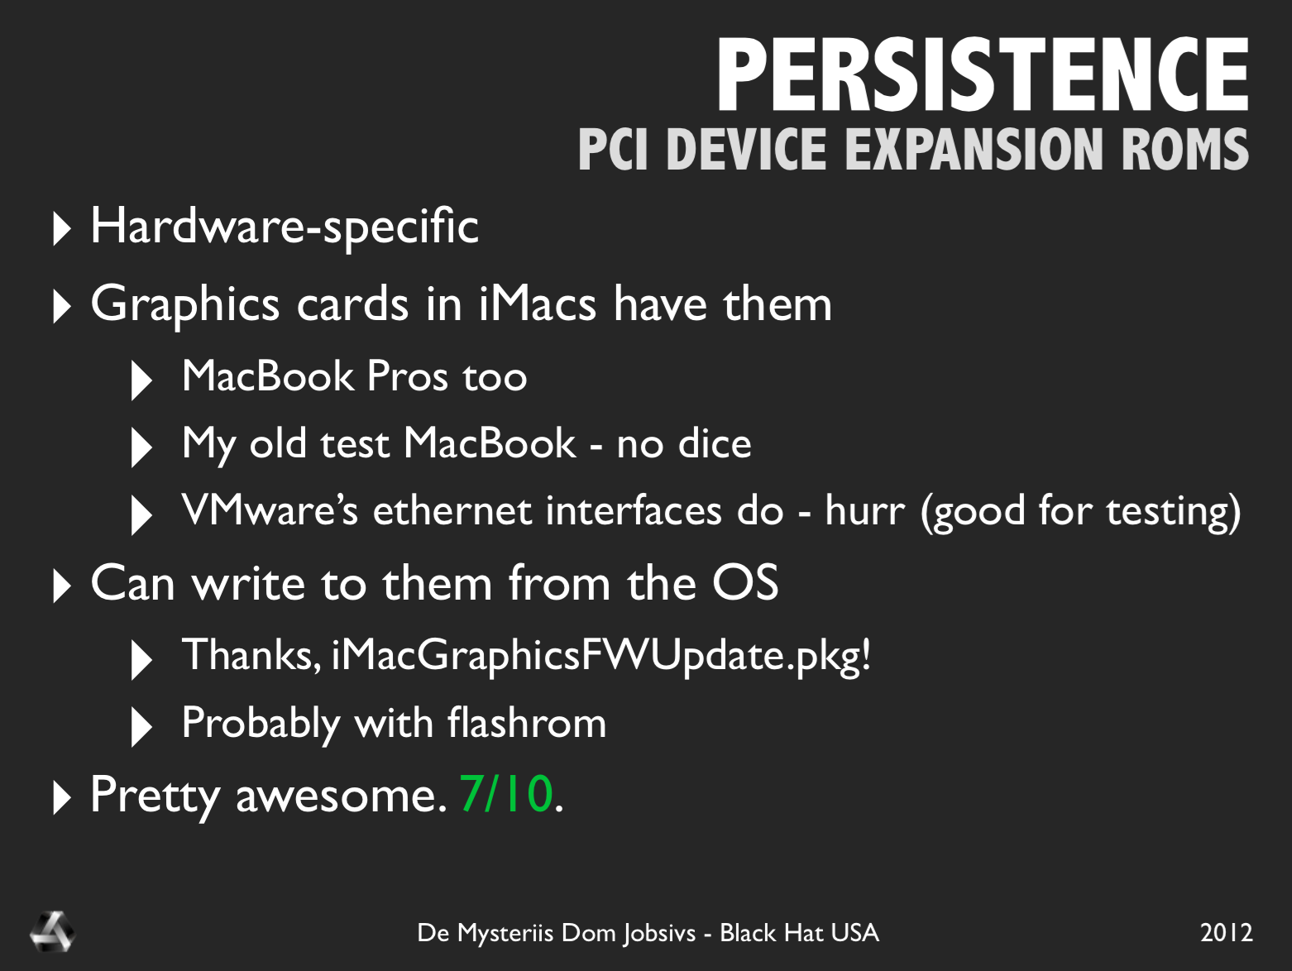

Slide 4


https://trmm.net/Thunderstrike_31c3

Slide 5
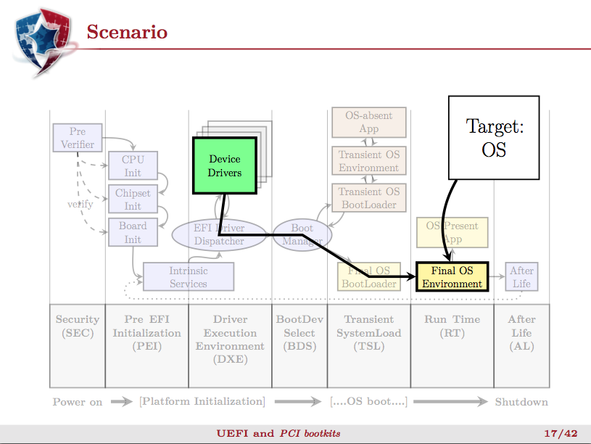

Pierre Chifflier, UEFI and PCI Bootkits, PacSec 2013 [34]
Notes:
http://www.zenzoneforum.com/attachment.php?attachmentid=16863&d=1341138411

Slide 6



TWO SIGMA
Thunderstrike 2: Sith Strike
Trammell Hudson – Two Sigma
Xeno Kovah, Corey Kallenberg – LebgaCore
Notes:
http://img4.wikia.nocookie.net/__cb20111224062752/starwars/images/7/73/TFUII-Force_Lightning.png

Slide 7
PCI/PCIe Expansion ROMs (XROMs) aka Option ROMs (OROMs)
A PCI/PCIe Expansion ROM is x86 native executable code located on a PCI device
Can technically have multiple architectures’ native code on it, so that the device can load just as well on a PPC device as an x86 one.
Not every device will have one
Graphics cards, network cards will likely have one
A device can have multiple XROMs (for multiple architectures)
Benign or otherwise this code gets executed by the CPU/BIOS during the boot process
They are handled the same on PCI Express as they are in PCI
They are configured via a separate BAR called the Expansion ROM Base Address Register

Slide 8
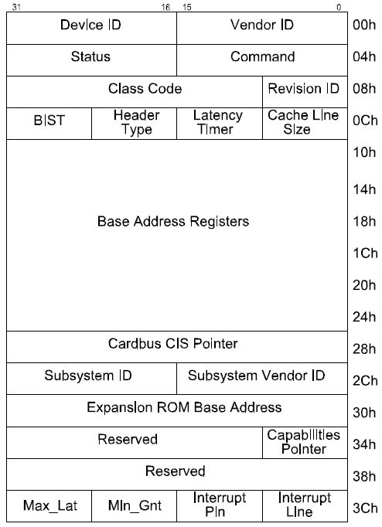
Expansion ROMs
XROMs have their own BAR called the Expansion ROM Base Address Register
On general type PCI devices it’s located at offset 30h
On bridge type devices it’s at 38h
BIOS initializes the XROM BAR like the other BARs, but hands off execution control to the code it points to
XROMs are copied to memory before being executed
On legacy systems they are copied to C0000 to DFFFFh range
The XROM BAR operates similarly to the other BARs but the interpretation of the field’s bits is slightly different
Notes:
*** UEFI XROM location

Slide 9
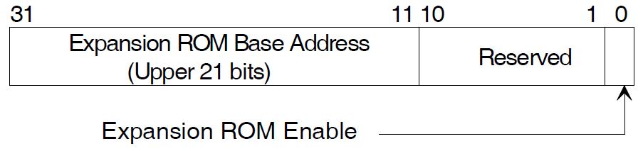
Expansion ROM Base Address Register
The LSB determines whether accesses to the Expansion ROM are permitted. When asserted to 1, they are permitted
Even when a device has an Expansion ROM, its BAR may still be 0 (meaning access to it is not permitted)
Like the PCI BARs, the Expansion ROM BAR is also R/W

Slide 10
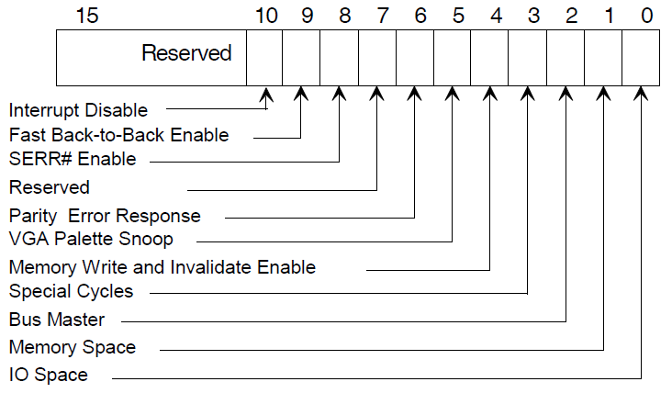
Command Register and Address Space Access
1
An expansion ROM will only respond to accesses if the Expansion ROM Enable bit and the memory space bit in the Command Register are both set
1
Notes:
Basically think of it as the PCI device has some default state, e.g. telling you whether it is 32 or 64 bit, whether it is prefetchable, whether it wants to map something into memory or IO, etc. The BIOS then comes along and saves this information, queries the mapping size by doing the write-1s, and then maps it wherever it wants to, and sets the appropriate command bits

Slide 11
How CPU/BIOS Discovers XROMs
1111 1111 1111 1111 1111 1
0
Expansion ROM Base Address Register
CPU/BIOS writes FFFF_F800h
To determine whether the device has implemented an Expansion ROM base:
All 1’s are written to the top 21 bits (31:11) of the Expansion ROM BAR
If the device returns anything other than 0, then it has implemented an Expansion ROM
Notes:
I have seen it written that 1’s are written to all bits except bit 0. I know I read it but can’t cite the source.
I’ve tried it both ways and get the same output either way. I choose the above way since this is how the Linux kernel does it (PCI_ROM_ADDRESS_MASK = ~7FFUL)

Slide 12
How CPU/BIOS Discovers XROMs
1111 1111 1111 1110 0000 0
0
Expansion ROM Base Address Register
Device returns FFFE_0000h
The return address indicates both the size of the ROM and the memory alignment (mask) required by the ROM:
Per the above example:
Size = ~FFFE_0000 +1 = 2_0000h bytes
ROM must be mapped to a 128KB-aligned memory address
So addresses like XXX00000, XXX20000, XXX40000, etc
Notes:
I have seen it written that 1’s are written to all bits except bit 0. I know I read it but can’t cite the source.
I’ve tried it both ways and get the same output either way. I choose the above way since this is how the Linux kernel does it (PCI_ROM_ADDRESS_MASK = ~7FFUL)

Slide 13
How CPU/BIOS Discovers XROMs
( Some memory address )
1
Expansion ROM Base Address Register
CPU/BIOS maps the ROM and enables it
Next the CPU/BIOS maps the ROM to an unused portion of memory
Then it sets the enable bit so that the ROM is now accessible at the address defined by the BIOS
Notes:
I have seen it written that 1’s are written to all bits except bit 0. I know I read it but can’t cite the source.
I’ve tried it both ways and get the same output either way. I choose the above way since this is how the Linux kernel does it (PCI_ROM_ADDRESS_MASK = ~7FFUL)

Slide 14
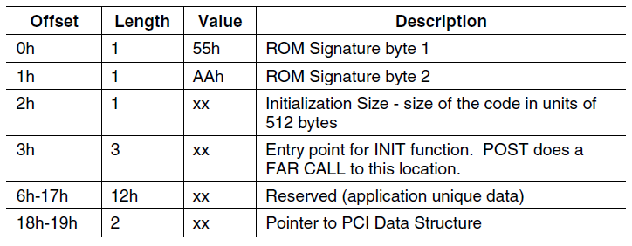
How CPU/BIOS Discovers XROMs
CPU/BIOS checks memory for Option ROM structure
If anything other than the “AA55” signature is present, there is actually no Option ROM provided by the device, despite the fact that it returns a mask as if there were
I have some ice cream. Want a lick? Psych!
There may still be an option ROM, however, some companies implement them in non-standard ways
PCI Express Revision 3.0
Notes:
I have seen it written that 1’s are written to all bits except bit 0. I know I read it but can’t cite the source.
I’ve tried it both ways and get the same output either way. I choose the above way since this is how the Linux kernel does it (PCI_ROM_ADDRESS_MASK = ~7FFUL)

Slide 15
CPU/BIOS Expansion ROM Discovery
A PCI device can share a decoder between the Expansion ROM BAR and other BARs
For example:
Some vendors mirror their Expansion ROMs at BAR[n] or at an offset from BAR[n]
NVidia sometimes puts them at BAR[0] + 30_0000h (per the developers of Flashrom )
http://flashrom.org/Flashrom
It is possible that there simply is no Expansion ROM present on the device
Could be located in a compressed module in the BIOS binary
Notes:
This whole process is wonky. The nVidia graphics XROM is at EFFE_0000h and there is NO rhyme or reason as to why that is (at least not per the PCI spec)
Writing FFFFF800 to the XROM BAR returns FFFE_0000h. So close… what’s the connection???

Slide 16
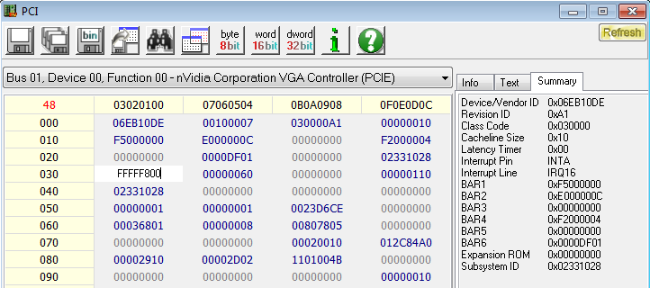
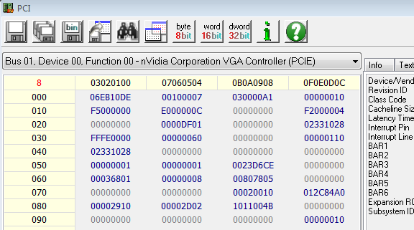
Expansion ROM Discovery: User Example (Same as BIOS)
This example pertains to the nVidia VGA card on the E6400 laptop
Verify that the memory-enable space bit 1 in the command register (offset 04h) is asserted
Writing FFFF_F800h to offset 30h returns FFFE_0000h indicating that an Expansion ROM [might be] present
Bit 17 is the LSB, which indicates a 128KB ROM
Size = ~FFFE_0000 + 1 = 2_0000h bytes

Slide 17
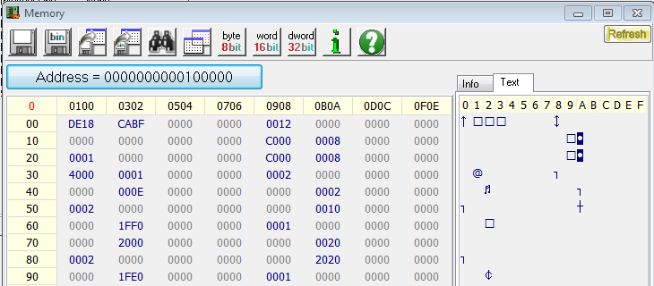
Expansion ROM Discovery: User Example (Same as BIOS)
00100001
We (or the BIOS) should be able to choose a memory address for the ROM to be mapped to
Address must meet alignment requirements
Address must provide enough room for the XROM
Must enable the XROM decoding (assert bit 0, enable)

Slide 18
Expansion ROM Discovery: User Example (Same as BIOS)
00100001
If there is anything other than the “AA55” XROM signature, then there is actually no option ROM present
As it turns out, in this case, there is no option ROM located on the device
This option ROM is located on the BIOS flash as a compressed module

Slide 19
Expansion ROM Hacking
Hacking an Expansion ROM typically requires reflashing the firmware on the device
Often the “RO” in “ROM” is a misnomer
Although in the case we just saw, modifying the BIOS itself could permit an attacker to insert a malicious XROM
If a vendor offers a utility to update the flash then you know the flash is writeable
Good reference on XROM hacking:
http://resources.infosecinstitute.com/pci-expansion-rom/
It’s important for Option ROMs to be measured (measured boot) before being executed

Slide 20
Secure Boot
Systems that support UEFI/Windows 8 Secure Boot require XROMs to be signed before it will execute them
Assuming you didn’t turn off SecureBoot
Apple systems don’t support SecureBoot, therefore what worked in 2012 still works today
The fact that systems load XROMs off external peripherals like the Thunderbolt Ethernet adapter make it just that much easier to attack Macs this way

Slide 21
References
https://sites.google.com/site/pinczakko/building-a-kernel-in-pci-expansion-rom (Darmawan Salihun)
http://www.blackhat.com/presentations/bh-dc-07/Heasman/Paper/bh-dc-07-Heasman-WP.pdf (John Heasman)
http://pacsec.jp/psj13/psj2013-day2_Pierre_pacsec-uefi-pci.pdf (Pierre Chifflier)
http://ho.ax/downloads/De_Mysteriis_Dom_Jobsivs_Black_Hat_Slides.pdf (Snare)
https://trmm.net/Thunderstrike (Trammel Hudson)
http://legbacore.com/Research_files/ts2-blackhat.pdf (Trammel Hudson, Xeno Kovah, Corey Kallenberg)

